Slide 1
Enabling Effective Utilization of GPUs for Data Management Systems
Xiaodong Zhang
The Ohio State University

Slide 2
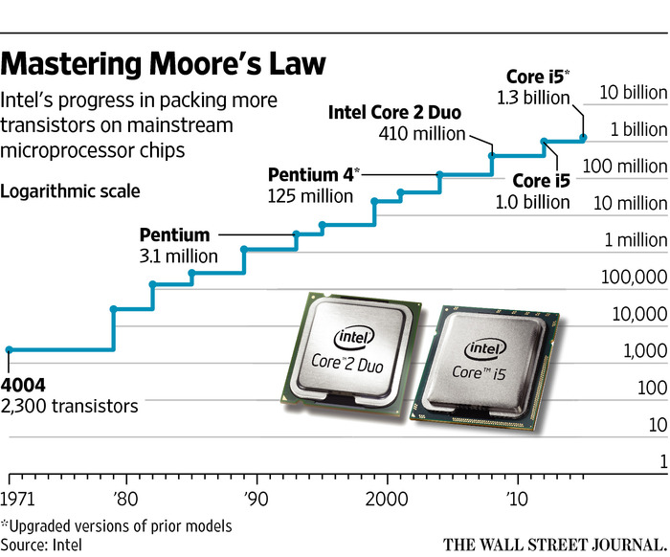
Moore’s Law is reaching to the end
We are closing to the final usable size limit a transistor gate length: 5 nm
Minimum cost per transistor has been rising since 28 nm chips a few years ago

Slide 3
Moore’s Law created a powerful homogeneous ecosystem
A simple and one-size-fit-all computing abstraction
Any task is divided by a sequence of standard execution time unit
Under multiprogramming model, OS assigns time unit to each task by turns
Data blocks are moved around in the memory hierarchy
Programing and execution models are standardized
Moore’s law continues to reduce execution time, but
Efficiency continues to become low in both power and execution
Other models are not included, e.g. SIMD, and other domain specific ones
As Moore’s law is ending
General-purpose computing needs a lot of external help
Hardware accelerators provide such a support

Slide 4
Continued Demand: High Throughput and Low Latency
Optimal Point
Latency (locality)
Throughput (parallelism)
Number of Concurrent Processes

Slide 5
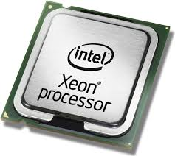
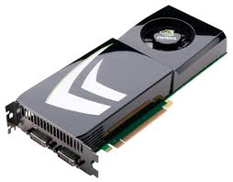
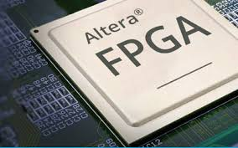
Hardware devices Becomes Heterogeneous
CPU
GPU
FPGA
Data processing systems must efficiently utilize external hardware devices for continued high performance

Slide 6
High Performance Computing is Scale-up based
Scaling up
Maximize parallelism as the number of computing nodes and workload scale, and minimize latency
High scalability is achieved by hardware/software
Achieving high parallelism
Exploiting locality to reduce latency
High performance is gained by
HPC scalability = parallelism / latency
Implementation
Upgrading hardware and software optimization

Slide 7
Same Efforts to achieve high Scalability in BD systems
Scaling out
Raising throughput as the number of computing nodes and workload scale, subject to an acceptable latency
High scalability is achieved by
Maximizing parallelism to raise throughput
Exploiting locality to reduce latency

Slide 8
A sustained scalability is archived in large data systems by finding a proper balanced point between parallelism and latency

Slide 9
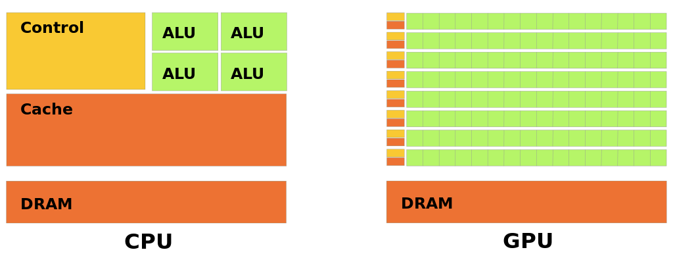
Architecture Differences: CPU vs. GPU
Control
Cache
Massive ALUs
Intel Xeon E5-2650v2:
2.3 billion Transistors
8 Cores
59.7 GB/s memory bandwidth (2013)
Nvidia GTX 780:
7 billion Transistors
2,304 Cores
288.4 GB/s memory bandwidth (2013)

Slide 10
GPU is fast to compute and access own memory
GPUs are powerful (2016)
GPUs become easy to program
CUDA and OpenCL
Computing Power
(GFLOPS)
Memory Bandwidth
(GB/s)
CPU
1,436
102
GPU
10,609
(7.4X)
720
(7.1X)

Slide 11
Advantages on Parallelism and Low Latency
Massive number of Parallel Processing Units in GPU
To process a large number of simple and independent memory access operations
Massively Hiding Random Memory Access Latency
GPU can effectively hide memory latency with massive hardware threads and zero-overhead thread scheduling by hardware support
Notes:
We find that GPUs have several advantages for kv stores. First, it has massive processing units. The operations in kv stores are simple independent memory accesses, while the thousands of cores in GPUs are ideal for massive parallel processing. Second, it has an ability of massively hiding memory access latency. As we have shown previously, lots of random memory accesses are involved in index operations, and GPUs can effectively hide them with …

Slide 12
Advantages on Parallelism and Low Latency
Massive number of GPU Processing Units
To process a large number of simple independent memory access operations
Massively Hiding Random Memory Access Latency
GPUs can effectively hide memory latency with massive hardware threads and zero-overhead thread scheduling by hardware support
memory request issued,
switch to another thread
memory request issued,
switch to another thread
cache
miss
cache
miss
Thread A
…
…
Thread B
Thread C
…
GPU Core
Instruction Buffer

Slide 13
Can we simply offload parallel operations on CPU to GPUs to further improve performance?
No
Notes:
Since Spark is designed around RDD,
Can we simply offload RDD operations to GPUs to get better performance?
The answer is no due to the mismatches between Spark’s designs and GPU’s unique characteristics

Slide 14
Challenge #1: Mismatch of Programming Model
E.g., Spark is implemented in Scala and runs on top of Java Virtual Machine
GPU is usually programed with CUDA and OpenCL
A pined memory area by CudaMalloctHost for “non-swampble”
Spark Executor
Java Virtual Machine
Spark Executor
Java Virtual Machine
Task
Task
Task
Task
RDD
RDD
RDD
RDD
GPU Kernels
1
GPU Memory
OS Pageble Memory
3
2
Pinned Memory
PCIe

Slide 15
Challenge #2: Mismatch in Execution Models and Data Formats
E.g. Spark: one element a time iterator model, row format
GPU: block processing in SIMD fashion, column format
2
1
Burk
CS
Professor
110,000
People
RDD
Filter
RDD
Terry
CS
Professor
95,000
3
4
Luis
EE
Staff
80,000
Start
Block 1

Slide 16
Challenge #3: Inability of time/space sharing and scheduling in GPUs or between CPU and GPU
Coarse grained management
Fine grained management
These operations can be overlapped
JVM
Host to GPU
Kernel
GPU to Host
JVM
GPU
Task 1
GPU
Task 2
CPU 1
GPU
Task 1
JVM
Host to GPU
Kernel
GPU to Host
JVM
GPU
Task 3
GPU
Task 4
CPU 2
GPU
Task 2
JVM
Host to GPU
Kernel
GPU to Host
JVM
Spark worker
CPU 3
GPU
Task 3
JVM
Host to GPU
Kernel
GPU to Host
JVM
4- Core CPU
GPU
CPU 4
GPU
Task 4
JVM
Host to GPU
Kernel
GPU to Host
JVM
Time
Time

Slide 17

Evolution of GPU Programming and Execution Environment
System APIs
Advanced System APIs
GPU
CPU
GPU
CPU
GPU
CPU
GPU
Manually program
+: high performance
-: app-dependent
-: GPU only
e.g. Cuda Library
Manually program both
+: high performance on one
-: app-dependent
-: hard to coordinate
e.g. GPU-DB, Caffe, …
Separate interfaces
+: high performance on one
+: general purpose for CPU
-: app-dependent for GPU
-: hard to coordinate
e.g. Hive, Spark, …
An inclusive environment
+: Retain all the merits
+: address all the limits
-: is overhead affordable?
It is a challenging task

Slide 18
Internet is an Inclusive Environment
Foundation
Uniform Resource Identifier (URL): a character string to identify data source
Hypertext Transfer Protocol (HTTP): Web content exchange among nodes
Hypertext Markup Language (HTML): to express Web content
Web browser: an execution platform to retrieve contents from other nodes
First Web page in the world and after then
http://info.cern.ch, August 6, 1991
Less than 3,000 Websites, 1994
More than 1 billion Website in the world today
The inclusive environment support all kinds of human interactions
Web pages, Youtube, Skype, WeChat, Internet-Shopping, …

Slide 19
Four different efforts to develop a GPU-inclusive system
Highly optimized libraries
Commonly used components that are best suitable to GPUs with a well-defined interface for users of different applications.
Specifically defined Framework and abstractions
A programming framework to include GPU execution
Domain specific languages
A language for a specifying class of applications on GPUs
Inclusive system software
OS to manage both CPU and GPU

Slide 20
GPU Libraries: a simple and effective approach
Based on highly optimized algorithms and functions
Written in a commonly adopted language, such as CUDA
can easily incorporate into users’ applications with minimal changes to the existing code
PixelBox algorithm (VLDB’12) is such an example
We provide GPU solutions for pathology image processing
The PixelBox algorithm accelerates computational geometry
The work has been adopted by commercial software (GPP)
Included in GPU-Accelerated Libraries of NVIDIA
Limits this approach
GPU programming only, and GPU is still an external device

Slide 21
GPU-RDD: an abstraction to include GPU in SPARK
GPU-RDD is designed for GPU processing
Support both column and row format
Manage data in OS native memory and GPU memory to minimize data movement overhead
Application provides customized GPU functions that operate on the data

Slide 22
System Architecture of Spark-GPU
SQL Queries
Applications implemented with procedural processing interface
User Programs
Spark-GPU
Driver
GPU-Aware Query Optimizer
GPU-Aware Task Scheduler
GPU-Aware Resource Manager
Spark-GPU Workers
Spark Executor JVM
Spark Executor JVM
CPU
Task
GPU
Task
GPU
Task
GPU
Task
CPU
Task
GPU
Task
GPU
Task
GPU
Task
Spark Executor JVM
Spark Executor JVM
CPU
Task
GPU
Task
GPU
Task
GPU
Task
CPU
Task
GPU
Task
GPU
Task
GPU
Task
Spark Executor JVM
Spark Executor JVM
CPU
Task
GPU
Task
GPU
Task
GPU
Task
CPU
Task
GPU
Task
GPU
Task
GPU
Task
GPU Management Library
GPU Management Library
GPU Management Library
GPU Management Library
GPU Management Library
GPU Management Library
OS
GPU
OS
GPU
OS
GPU
OS
GPU
OS
GPU
OS
GPU

Slide 23
How dose Spark become a GPU inclusive?
Specialized
Library
Spark (RDD)
Spark (RDD)
Spark (RDD)
Spark-GPU
(RDD, GPU-RDD)
CPU
GPU
CPU
GPU
CPU
GPU
CPU
GPU
Poor performance
- Miss matches of both
Sub-optimal perf
- GPU is isolated
- No cordination
Sub-optimal Perf
- GPU is independent
- No coordination
An Effective Approach
-: Spark is changed

Slide 24
Domain Specific Language
Latte (PLDL 2016), a deep learning language
a language for describing deep neuron networks
A compiler to construct an implicit data-flow graph with optimization
Support data-parallelism
Can be well used in GPU environment for deep learning applications
Merits and Limits
highly efficient in domain specific areas
Not general purpose

Slide 25
System Software Support
Enhancing OS functions to manage GPUs
OS not only launches a GPU task but also cares about its
Process scheduling, memory management, and I/O
Adding additional management functions (VLDB’14)
Multiprogramming in GPU
Virtual memory in GPU
Merits and Limits
Raising GPU efficiency, avoid page faults
How to coordinate the two difference execution models

Slide 26
Conclusion
Existing system was not built to be inclusive
Three mismatches between GPU and the main stream
These mismatches also apply to others, such as FPGA.
Four different efforts to include GPU in the mainstream
They all have limits and merits.
We still have a long way to be totally inclusive
Best suitable operations should be automatically switch to GPUs
Programming environment should not GPU/CPU explicit

Slide 27
Thank you

